Slide 1
Introduction to data modeling and database design

Slide 2
MOTIVATION FOR STUDYING data Modeling / Database management
United States Department of Labor:
60% of new jobs require IS skills
Databases are everywhere
Alerts of suspicious activity on credit cards
Used in almost all applications of analytics
Pandora
CVS
Behind almost every website, web browser, smartphone, etc.
Integral part of almost any business
It is important to be comfortable creating data models and using databases in this all-digital world we live it
Need data modeling in order to create a database!

Slide 3
How big are databases?
Really (really) depends on the size of the organization/purpose that it is serving
I use a database to organize grades
Easily fits on a pen drive
Large organizations
Up to 10^15 bytes

Slide 4
outline
Define terms
Discuss conventional file processing systems, and their limitations
Explain advantages of databases
Identify costs and risks of databases
Introduction to drawing data models

Slide 5
Definitions
Database: organized collection of logically related data
We will be talking about relational databases
Others include NoSQL, object-relational, etc.
Data: stored representations of meaningful objects and events
Structured: numbers, text, dates
Unstructured: images, video, documents
Information: data processed to increase knowledge in the person using the data
Metadata: data that describes the properties and context of user data

Slide 6
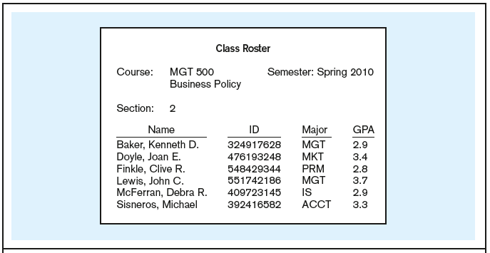
Data in context
Context helps users understand data
6

Slide 7

Summarized data - INFORMATION
Graphical displays turn data into useful information that managers can use for decision making and interpretation
7

Slide 8
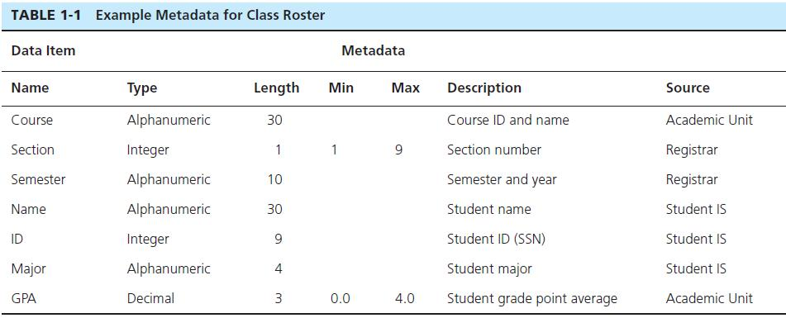
Descriptions of the properties or characteristics of the data, including data types, field sizes, allowable values, and data context
8

Slide 9
outline
Define terms
Discuss conventional file processing systems, and their limitations
Explain advantages of databases
Identify costs and risks of databases
Introduction to drawing data models

Slide 10
File Processing Systems
Existed prior to Database Management Systems (DBMS)
Can be defined as: A system used to store and manage data that involves each department or area within an organization having its own set of files

Slide 11
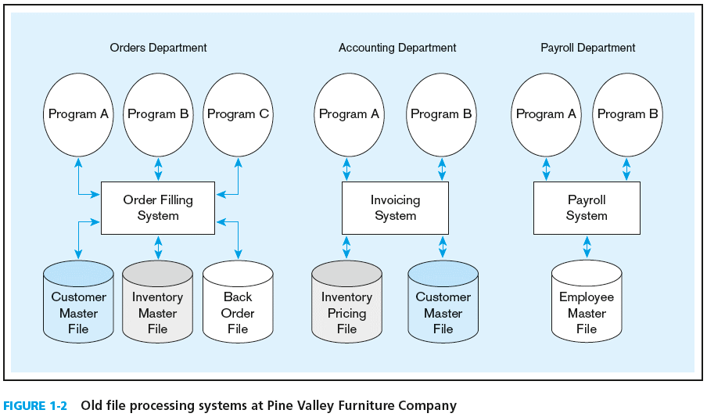
File Processing Systems
11

Slide 12
Disadvantages of File Processing
Duplication of Data (in different departments, for example)
Different systems/programs have separate copies of the same data
Waste of space (memory)
Updates – need to update each file!
Program-Data Dependence
All programs need to understand/read data
New programs must again create sub-procedures for understanding/reading data
If data format is changed(ex: international codes) each program that reads data has to be found and altered
Leads to lengthy development times

Slide 13
SOLUTION: The DATABASE Approach
Central repository of shared data
Data is managed by a controlling agent
Stored in a standardized, convenient form
Requires a Database Management System (DBMS)
Anyone know of a DBMS?
Oracle
MySQL
Microsoft SQL Server
Access
MongoDB

Slide 14
outline
Define terms
Discuss conventional file processing systems, and their limitations
Explain advantages of databases
Identify costs and risks of databases
Introduction to drawing data models

Slide 15
Database Management System
A software system that is used to create, maintain, and provide controlled access to user databases
Order Filing
System
Central database
Contains employee,
order, inventory,
pricing, and
customer data
Invoicing
System
DBMS
Payroll
System
DBMS manages data resources like an operating system manages hardware resources

Slide 16
Advantages of THE DatabaSE APPROACH
Program-data independence
Planned data redundancy
Improved data consistency
Improved data sharing
Increased application development productivity
Enforcement of standards
Improved data quality
Improved data accessibility and responsiveness
Reduced program maintenance

Slide 17
outline
Define terms
Discuss conventional file processing systems, and their limitations
Explain advantages of databases
Identify costs and risks of databases
Introduction to drawing data models

Slide 18
Costs and Risks of the Database Approach
New, specialized personnel
Installation and management cost and complexity
Conversion costs
Need for explicit backup and recovery
Organizational conflict

Slide 19
outline
Define terms
Discuss conventional file processing systems, and their limitations
Explain advantages of databases
Identify costs and risks of databases
Introduction to drawing data models

Slide 20
Elements of the Database Approach
Data models
Graphical system capturing nature and relationship of data – give business rules
Enterprise Data Model–high-level entities and relationships for the organization
Project Data Model–more detailed view, matching data structure in database or data warehouse
Entities
Noun form describing a person, place, object, event, or concept
Composed of attributes, which is the data that you are interested in capturing
Relationships
Between entities
Usually one-to-many (1:M) or many-to-many (M:N)
Relational Databases
Database technology involving tables (relations) representing entities and primary/foreign keys representing relationships

Slide 21
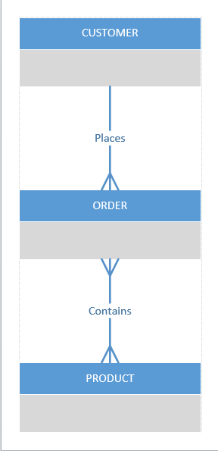
DATA MODEL
Business rules:
A customer places 1 to many orders
An order is placed by exact 1 customer
An order contains one to many products
A product is contained in 1 to many orders
Let’s draw it in Visio!
21

Slide 22
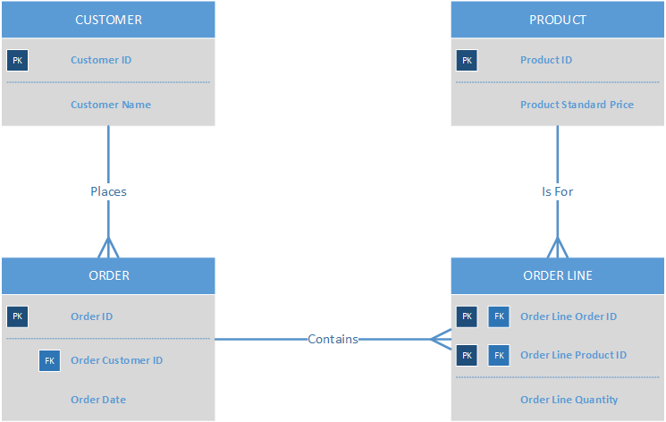
More specifically, it will be drawn like this …
22

Slide 23
One customer may place many orders, but each order is placed by a single customer
→ One-to-many relationship
23

Slide 24
One order has many order lines; each order line is associated with a single order
→ One-to-many relationship
24

Slide 25
One product can be in many order lines, each order line refers to a single product
→ One-to-many relationship
25

Slide 26
Therefore, one order involves many products and one product is involved in many orders
→ Many-to-many relationship
26

Slide 27
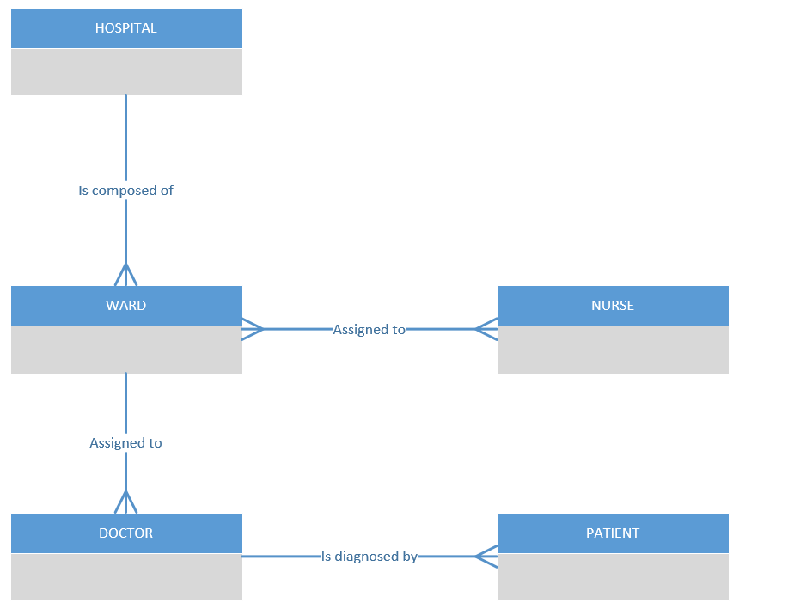
27

Slide 28
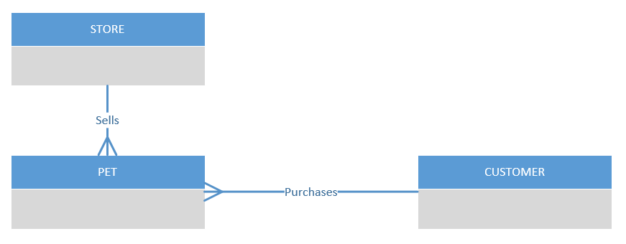
Examples
For each of the following pairs of related entities, indicate whether there is a one-to-many or a many-to-many relationship. Then, using the shorthand notation we just reviewed, draw a diagram for each of the relationships in Visio:
STUDENT and COURSE
BOOK and BOOK COPY
COURSE and SECTION
SECTION and ROOM
INSTRUCTOR and COURSE
Consider the following enterprise data model:
What is the relationship between Pet and Store?
What is the relationship between Customer and Pet?
Do you think that there should be a relationship between Customer and Store?
Consider UConn. Define several major data entity types and draw a preliminary enterprise data model.
Try using INSTRUCTOR, COURSE, SECTION, SCHOOL, STUDENT

Slide 29
Examples
Can be more complicated …
Let’s try to draw the PATIENT and PHYSICIAN model under the following scenario
A physician treats one or more patients, and a given patient can be treated by multiple physicians.
A patient is diagnosed by one and only one physician, and a physician can provide a medical diagnosis to many patients

Slide 30
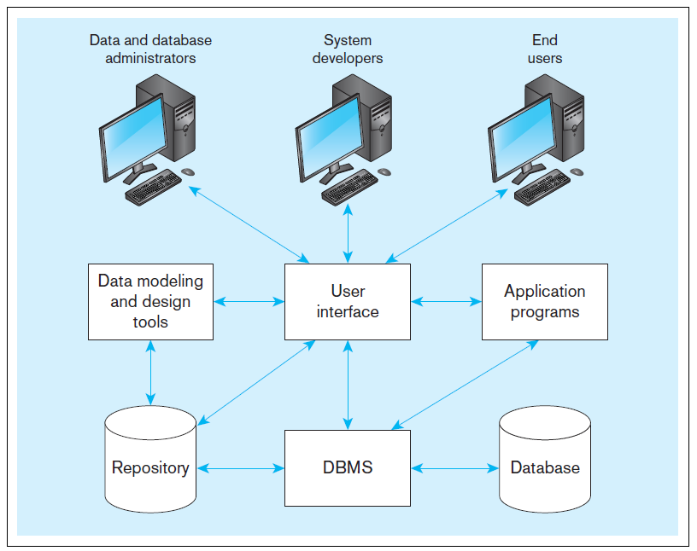
Components of the Database Environment

Slide 31
Components of the Database Environment
Data modeling and design tools -- automated tools used to design databases and application programs
Repository–centralized storehouse of metadata
Database Management System (DBMS) –software for managing the database
Database–storehouse of the data
Application Programs–software using the data
User Interface–text and graphical displays to users
Data/Database Administrators–personnel responsible for maintaining the database
System Developers–personnel responsible for designing databases and software
End Users–people who use the applications and databases

Slide 32
Database development process
SDLC
System Development Life Cycle
Detailed, well-planned development process
Time-consuming, but comprehensive
Long development cycle
Prototyping
Rapid application development (RAD)
Cursory attempt at conceptual data modeling
Define database during development of initial prototype
Repeat implementation and maintenance activities with new prototype versions
Starts with Enterprise Data Model …

Slide 33
Enterprise Data Model
First step in the database development process
Specifies scope and general content
Overall picture of organizational data at high level of abstraction
Review current systems
Analyze nature of business areas
Describe data needed
Entity-relationship diagram
Descriptions of entity types
Relationships between entities
Business rules
Sometimes create Business Function Matrix
NOT the database design

Slide 34
Two Approaches to Database and IS Development
SDLC
System Development Life Cycle
Detailed, well-planned development process
Time-consuming, but comprehensive
Long development cycle
Prototyping
Rapid application development (RAD)
Cursory attempt at conceptual data modeling
Define database during development of initial prototype
Repeat implementation and maintenance activities with new prototype versions

Slide 35
Systems Development Life Cycle
Planning
Analysis
Logical Design
Physical Design
Implementation
Maintenance

Slide 36
Planning
Purpose–preliminary understanding
Deliverable–request for study
Planning
Analysis
Logical Design
Physical Design
Database activity–
enterprise modeling and early conceptual data modeling
Implementation
Maintenance

Slide 37
Purpose–thorough requirements analysis and structuring
Deliverable–functional system specifications
Planning
Analysis
Analysis
Logical Design
Physical Design
Database activity–thorough and integrated conceptual data modeling
Implementation
Maintenance

Slide 38
Purpose–information requirements elicitation and structure
Deliverable–detailed design specifications
Planning
Analysis
Logical Design
Logical Design
Physical Design
Database activity–
logical database design (transactions, forms, displays, views, data integrity and security)
Implementation
Maintenance

Slide 39
Purpose–develop technology and organizational specifications
Deliverable–program/data structures, technology purchases, organization redesigns
Planning
Analysis
Logical Design
Physical Design
Physical Design
Database activity–
physical database design (define database to DBMS, physical data organization, database processing programs)
Implementation
Maintenance

Slide 40
Purpose–programming, testing, training, installation, documenting
Deliverable–operational programs, documentation, training materials
Planning
Analysis
Logical Design
Physical Design
Database activity–
database implementation, including coded programs, documentation, installation and conversion
Implementation
Implementation
Maintenance

Slide 41
Planning
Purpose–monitor, repair, enhance
Deliverable–periodic audits
Analysis
Logical Design
Physical Design
Database activity–
database maintenance, performance analysis and tuning, error corrections
Implementation
Maintenance
Maintenance

Slide 42
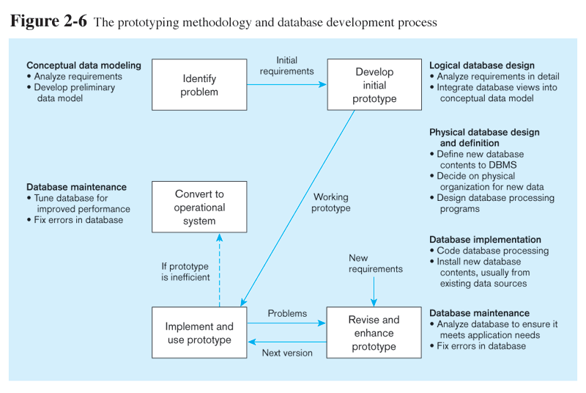
Prototyping Database Methodology

Slide 43
Prototyping Database Methodology
43

Slide 44
Prototyping Database Methodology
44

Slide 45
Prototyping Database Methodology
45

Slide 46
Evolution of Database Systems
Driven by four main objectives:
Need for program-data independence ➔ reduced maintenance
Desire to manage more complex data types and structures
Ease of data access for less technical personnel
Need for more powerful decision support platforms

Slide 47
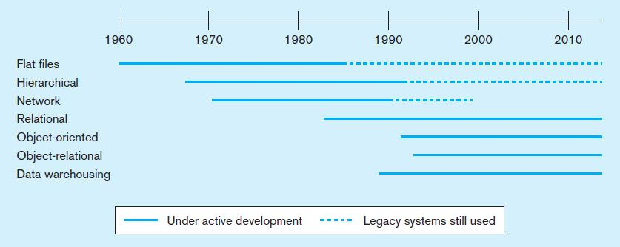
Evolution of database technologies

Slide 48
Class Assignment
Draw an ER diagram for the following situation. First define the entities, and then draw the relationship lines in Visio.
Consider an HR department for an international company. The company has departments which are assigned to a given location. Each location can have any number of departments assigned to it. In addition, every location is identified by a country that it is located in, with potentially many locations for each country. Countries are contained in continents.
Employees are assigned to one and only one department, but departments can have any number of employees. Each employee also has a job with any number of employees doing each job.
Entities: DEPARTMENT, LOCATION, COUNTRY, CONTINENT, EMPLOYEE, JOB

